Slide 1
Lesson 16: The Cost Of Discipleship (Probably Peræa.)
Luke 14:25-35
August 25, 2021

Slide 2
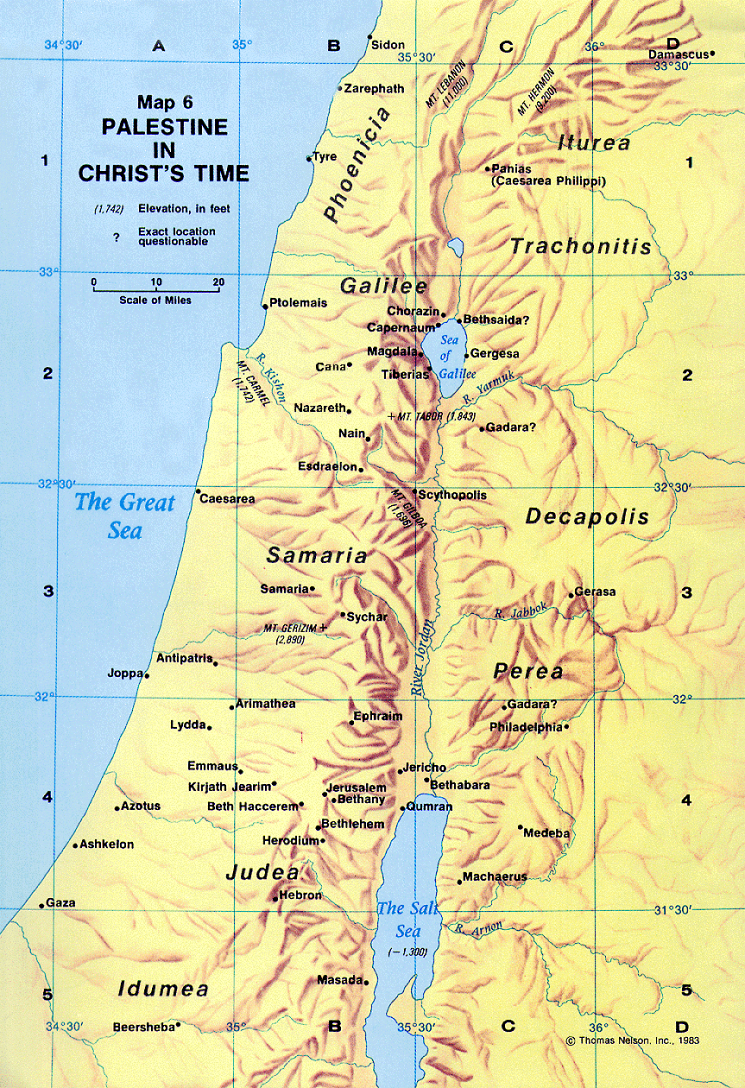

Slide 3
The Cost Of Discipleship
Luke 14:25, “Now there went with him great multitudes: and he turned, and said unto them”
cf. John 10:40-42 – Because of their hostility, Jesus went … across the Jordan to Perea, which had been the location of John the Baptist’s activity (1:28).
Jesus’ ministry here was received much more favorably, probably because John the Baptist had prepared the people there.
John, even though dead, was still having influence in people’s lives as they remembered his witness. Though John never performed a miraculous sign the people believed his witness about Jesus.
By contrast, the hostile Jerusalem crowd had seen His signs and yet disobeyed. In Perea many trusted Jesus as Savior.
Likely that most of these were going to Jerusalem themselves to worship at the Passover feast.

Slide 4
The Cost Of Discipleship
Luke 14:26, “If any man cometh unto me, and hateth not his own father, and mother, and wife, and children, and brethren, and sisters, yea, and his own life also, he cannot be my disciple.”
“Any man.” All are included, no exclusions. cf. Luke 9:23; Mark 8:34; cf. 2 Corinthians 5:17
“Hateth” (miséœ) is to be understood as loving less.
This is made clear in Matthew 10:37, “He that loveth father or mother more than me is not worthy of me: and he that loveth son or daughter more than me is not worthy of me.”
Jesus commanded, “Thou shalt love thy neighbor as thyself” (Matthew 19:19).

Slide 5
The Cost Of Discipleship
Luke 14:26, “If any man cometh unto me, and hateth not his own father, and mother, and wife, and children, and brethren, and sisters, yea, and his own life also, he cannot be my disciple.”
When it comes to loving God, however, He is placed in a unique position. Matthew 22:37-38
To construe this passage literally as enjoining hatred would be contrary to everything Jesus taught about honoring parents. Ephesians 6:1-3; Colossians 3:20
One is to love his wife as himself. Ephesians 5:25
It would also be contrary to our Lord’s own example. John 19:25–27
We are not to loathe or detest any other human being.

Slide 6
The Cost Of Discipleship
Luke 14:27, “Whosoever doth not bear his own cross, and come after me, cannot be my disciple.”
Luke 9:23, “And he said unto all, If any man would come after me, let him deny himself, and take up his cross daily, and follow me.” cf. Matthew 10:38; 16:24; Mark 8:34
NOTE: Lenski says, “… discipleship demands much from which the natural man is bound to shrink, a certain hate of what the natural man counts most dear, and a certain love for what the natural man always hates” (Lenski, page 787).

Slide 7
The Cost Of Discipleship
Luke 14:28-30, “For which of you, desiring to build a tower, doth not first sit down and count the cost, whether he have (wherewith) to complete it? Lest haply, when he hath laid a foundation, and is not able to finish, all that behold begin to mock him, saying, This man began to build, and was not able to finish.”
Luke 14:31-32, “Or what king, as he goeth to encounter another king in war, will not sit down first and take counsel whether he is able with ten thousand to meet him that cometh against him with twenty thousand? Or else, while the other is yet a great way off, he sendeth an ambassage, and asketh conditions of peace.”
The wise man may build a house or wage war but he considers it first and seeks counsel. (Proverbs 24:1-6; Galatians 3:2-4; 1 Corinthians 15:58; 2 Peter 2:20-22; 2 John 8).

Slide 8
The Cost Of Discipleship
Luke 14:33, “So therefore whosoever he be of you that renounceth not all that he hath, he cannot be my disciple.”
In our efforts to convert others, we emphasize the wonderful privileges that a Christian enjoys.
However, we have failed to point out, with equal fervor, the great responsibilities imposed by the Lord upon those who would become His disciples!

Slide 9
The Cost Of Discipleship
Luke 14:33, “So therefore whosoever he be of you that renounceth not all that he hath, he cannot be my disciple.”
What is a disciple?
Primarily a disciple is a learner. Biblically, a disciple is more than a learner; he is a follower and an adherent of his teacher.
One reads of the disciples of Moses, Isaiah, John the Baptist, and Jesus. Isaiah 8:16; Matthew 15:1; John 3:25; 9:28

Slide 10
The Cost Of Discipleship
Luke 14:33, “So therefore whosoever he be of you that renounceth not all that he hath, he cannot be my disciple.”
Jesus explained the process of making disciples:
“They shall be taught of God. Every one that has heard from the Father, and has learned, comes unto me” (John 6:45).
His final directions (Matthew 28:19,20) were for His apostles in going to all nations to do three things: (1) make disciples, (2) baptize them and (3) teach them.
The book of Acts shows us how the apostles followed the Lord’s instructions:
Disciples were made,
Were baptized and,
Were taught in Jerusalem, Antioch, Iconium, Lystra, Derbe, Corinth, and Ephesus (Acts 2:36-42; 14:21-22; 18:4, 8, 27; 19:5; 20:28).

Slide 11
The Cost Of Discipleship
Luke 14:33, “So therefore whosoever he be of you that renounceth not all that he hath, he cannot be my disciple.”
What man has done:
Go make converts,
Baptize them and,
Disciple them.
Note:
Jesus’ order was not to “go make converts” but to “go make disciples.”
All Christians are to “exhort” one another. 1 Thessalonians 2:1-12; 5:11
Elders. Acts 20:28

